Slide 1


INTERACTIVE PORTFOLIO
Using Front-End Development
Name: Raj Santosh Khedekar
Register No.: 24H218
NMID: asumn1301212402414
Department: BCA
College/ University Name: AM Jain College

Slide 2



AGENDA
Project Overview
End Users
Tools and Technologies
Portfolio Design and Layout
Features and Functionality
Portfolio Outcomes
Conclusions & GitHub Links
Page 02

Slide 3


PROJECT OVERVIEW
Built using: HTML, CSS, JavaScript
Features Included:
Responsive navigation bar with mobile menu & dark mode toggle.
About Me, Skills, Projects, Contact sections.
Fully functional contact form.
Scroll-to-top button for smooth navigation.
Responsive web design.
Clean, modern with animations.
Page 03

Slide 4
END USERS
Who are the End Users ?
Potential Employers / Recruiters → to view your skills, projects, and contact you.
Teachers / Mentors → to evaluate your learning and progress.
Clients → who may want to see your work before hiring you.
Peers & Friends → for collaboration, feedback, or inspiration.
Designed for anyone interested in your skills, projects, and professional growth.
Page 04

Slide 5
TOOLS & TECHNIQUES
HTML → Structure of the website.
CSS → Styling, layout, responsiveness, animations.
JavaScript → Interactivity (dark mode, mobile menu, scroll button).
FormSubmit → Handling contact form submissions.
GitHub Pages → Hosting & deployment.
AOS Library → Smooth scroll animations.
Demonstrates use of modern web development tools and best practices in responsive design.
Page 05

Slide 6
DESIGN & LAYOUT
Clean & Modern UI → Minimalist, professional look with smooth animations.
Responsive Layout → Works seamlessly on desktop, tablet, and mobile.
Hero Section → Intro, tagline, and circular profile image.
About Section → Brief background & goals.
Skills Section → Highlights core technical skills (HTML, CSS, JS).
Projects Section → Showcases completed work with cards & links.
Contact Section → Simple form for easy communication.
Dark Mode Support → Improves accessibility & user experience.
Page 06

Slide 7
FEATURES & FUNCTIONALITY
Responsive Navigation Bar → Works on desktop & mobile (hamburger menu).
Dark Mode Toggle → Saves user preference with localStorage.
Skills & Projects Showcase → Display technical skills & work samples.
Contact Form → Integrated with FormSubmit for easy communication.
Scroll-to-Top Button → Smooth navigation back to top.
Animations → Fade, zoom & slide effects while scrolling.
Footer with GitHub Link → Quick access to your profile.
Ensures a user-friendly, interactive, and professional experience.
Page 07

Slide 8

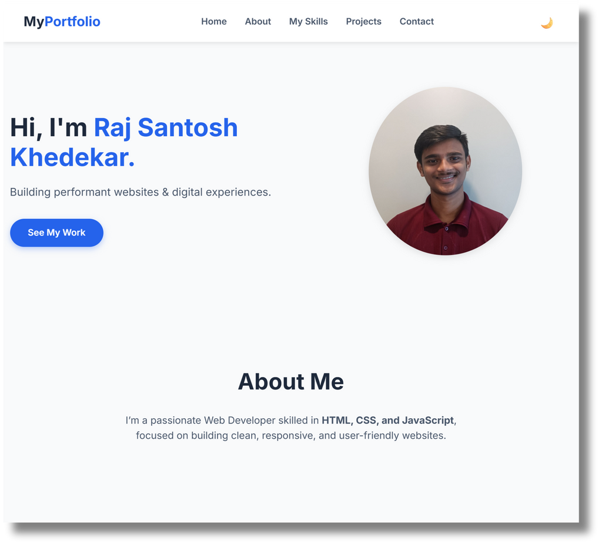
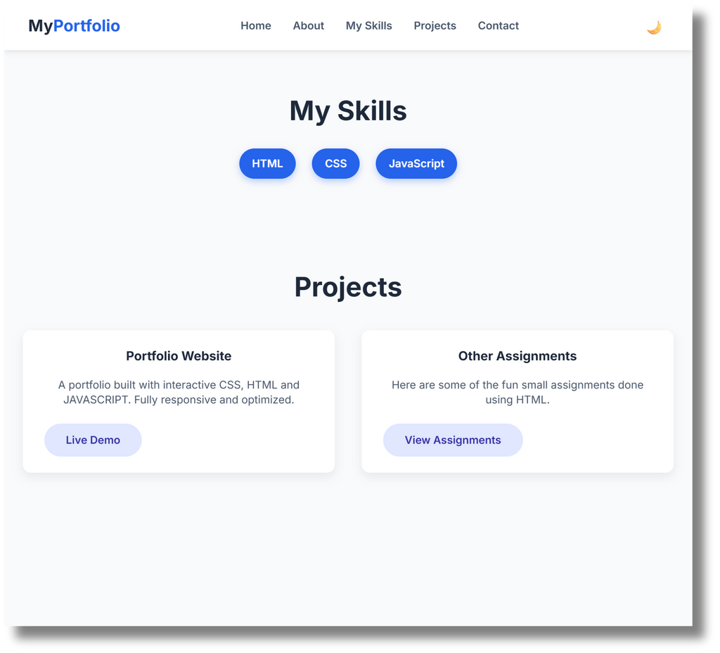

PORTFOLIO OUTCOME
Portfolio Result →
My portfolio
Page 08

Slide 9
CONCLUSION
Created a responsive, interactive portfolio website using HTML, CSS, and JavaScript.
Showcases personal skills, projects, and achievements in a professional way.
Integrated features like dark mode, animations, contact form, and mobile-friendly layout.
Demonstrates ability to apply modern web development practices.
Page 09

Slide 10

BENEFITS TO SOCIETY
Helps students & professionals present their skills digitally.
Makes it easier for employers and clients to discover talent.
Encourages others to build their own online presence.
GITHUB LINK
Github link
Page 10

Slide 11
THANK
YOU
Presented by-
RAJ SANTOSH KHEDEKAR
24H218 | II BCA C

